Slide 1

Introduction
Convert the static website into a dynamic, customizable, and flexible website using Django and PostgreSQL

Slide 2

Challenges with Static Websites
Difficulty in updating content frequently
Manual changes required for every update
Limited interactivity and personalization

Slide 3
DJango Framework
A high-level Python web framework for rapid development
Based on DRY principal’s (Do not Repeat Yourself)
eg. HTML Inheritance
Provides tools and features for building a dynamic website(template syntax)
Simplifies database management with flexibility

Slide 4
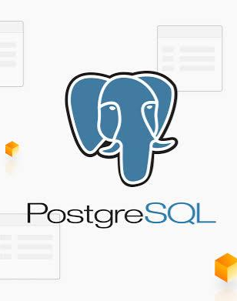
PostgreSQL
A powerful open-source relational database.
Seamless integration with Django using the Django ORM (Object-Relational Mapping)

Slide 5

Dynamic Content Generation
About page data, classes data, inquiry details, and gallery images stored in PostgreSQL
Django fetches data from the database and dynamically generates content on HTML pages

Slide 6

Admin Panel
Django admin panel for easy content management
Owner can update website content without technical knowledge
Improved control and flexibility over the website

Slide 7
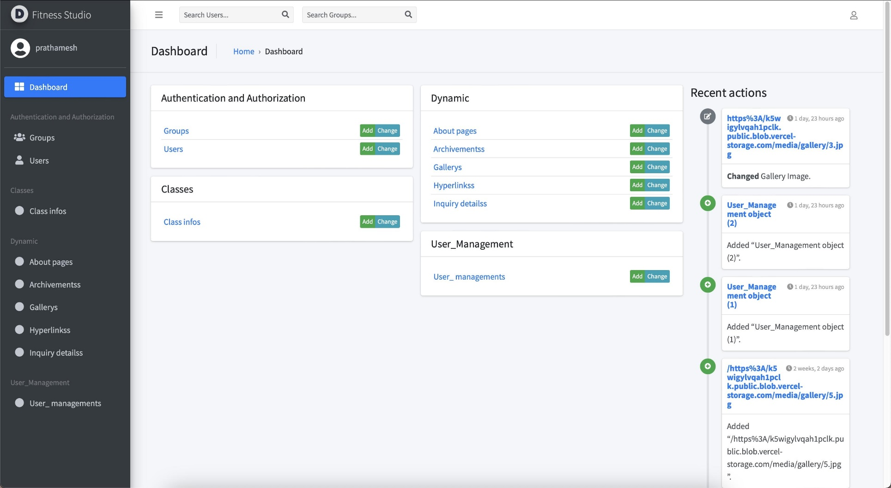
Admin Dashboard
Dashboard offers various Apps
Users and Group management
Add/Change any object
Keeps history of data

Slide 8
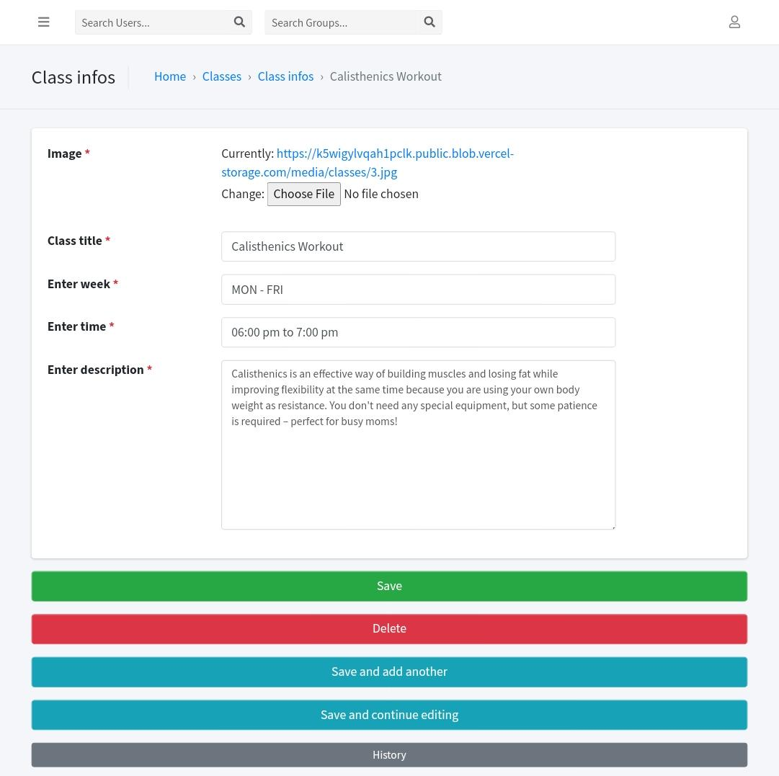
Classes Object
A form is opened and you can fill these details to store in the database
Delete any data (Object) if already exist
Owner can also check the history of the data

Slide 9
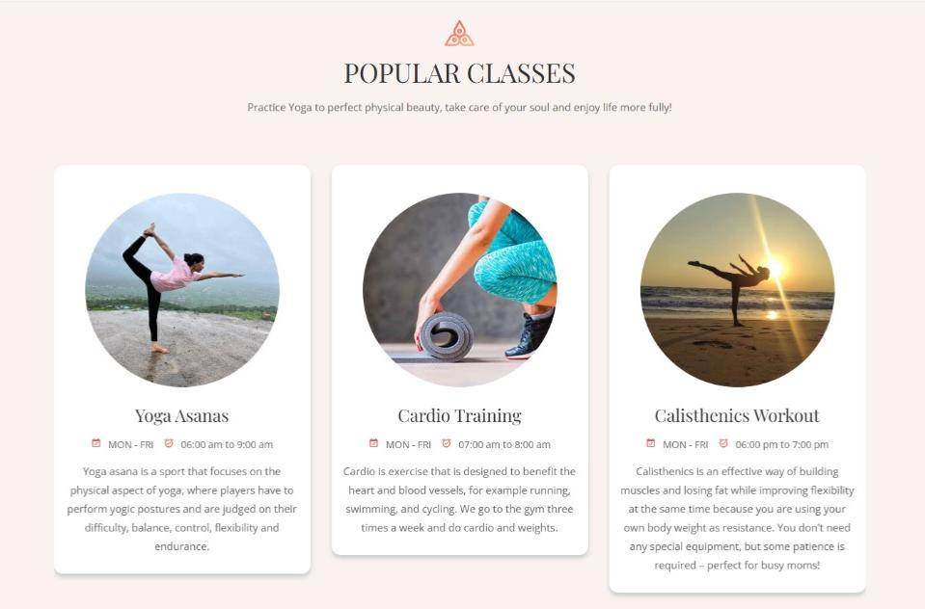
HTML Gerated Dynamically
Dynamically generates HTML page data
Easy to add, remove or change

Slide 10

Future Enhancements
Email notifications
Online fees payment integration

Slide 11
Deployment on Vercel
Platform for free and efficient deployment solution for project
Using Vercel’s postgreSQL DB and their blob storage for faster interoperability
Provides reliable hosting, scalable infrastructure, and easy integration with third-party services.
Ensures the website is accessible to users with minimal downtime
Live Deployed URL: dikshafitness.vercel.app

Slide 12

Conclusion
Successfully transformed a static website into a dynamic, user-friendly, and customizable platform using HTML, CSS, Django, and PostgreSQL.
Deployed the project on Vercel for efficient and accessible hosting.

Slide 13

Thank You

